Slide 1
Optical Flow - Final Project
Team 7

Slide 2
Outline
Optical Flow introduction
Kernel Architecture
Optimization
Timing & Resource Utilization
Result

Slide 3
Optical Flow introduction

Slide 4
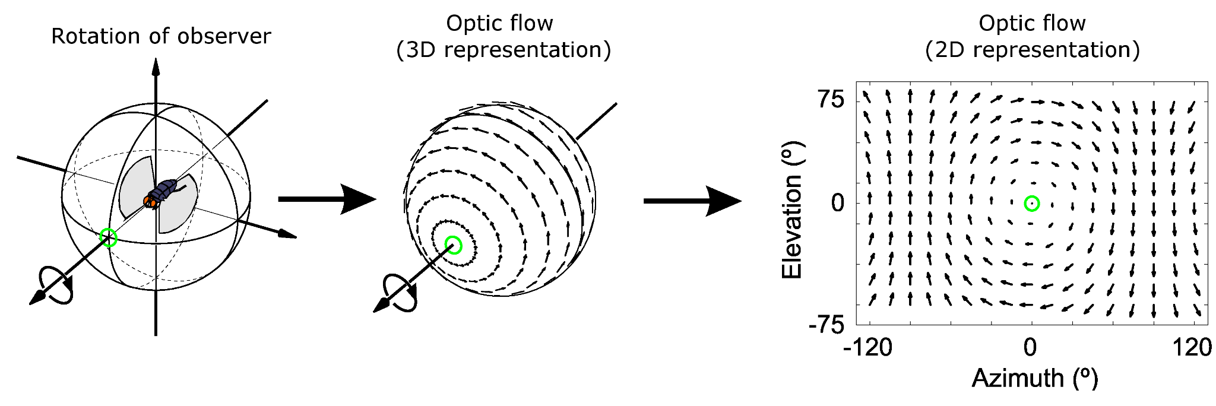
Optical Flow introduction
Optical flow or optic flow is the pattern of apparent motion of objects, surfaces, and edges in a visual scene caused by the relative motion between an observer and a scene.

Slide 5
Method
Lucas-Kanade algorithm
The Lucas-Kanade optical flow algorithm is a simple technique which can provide an estimate of the movement of interesting features in successive images of a scene.
Sparse (some pixels) or dense (all pixels)
No longer state-of-the-art but still widely referenced

Slide 6
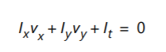
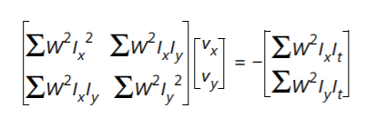
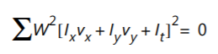
LK Optical Flow
Unknown motion vector in horizontal/vertical direction
I(x,y,t) = I(x+dx,y+dy,t+dt)
Weighted least-square fit, assuming constant velocity in each section
𝄔
𝄔
Spatial derivative
Temporal image brightness derivative
Window function

Slide 7
Constraint
1.The pixel intensity of the object between consecutive frames is constant
2. Similar motion between adjacent pixels

Slide 8
Kernel Architecture

Slide 9
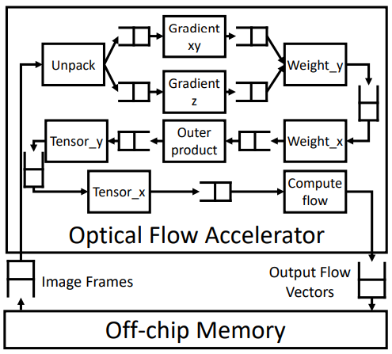
Hardware diagram(8 stage)
Stage1 : Unpack
Stage2 : Gradient xyz
Stage3 : weight_y
Stage4 : wright_x
Stage5 : outer product
Stage6 : Tensor_y
Stage7 : Tensor_x
Stage8 : Compute flow

Slide 10
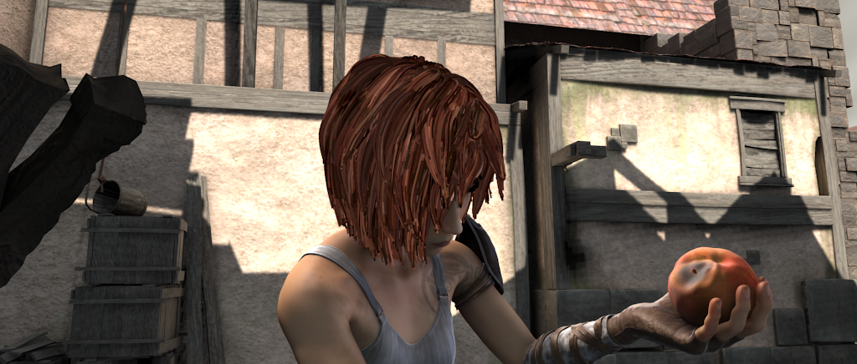
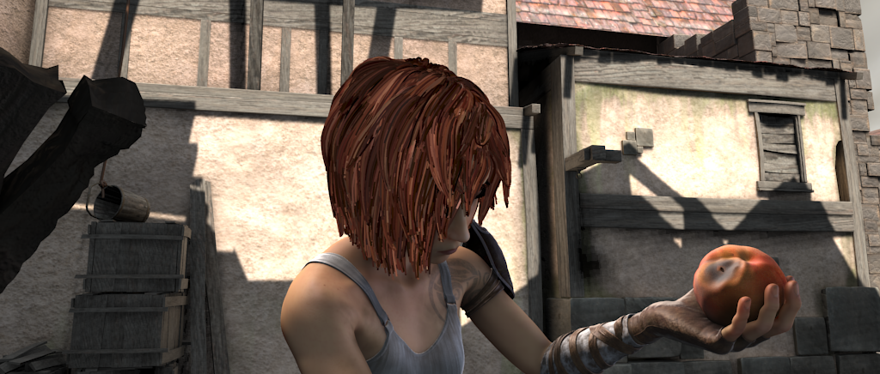
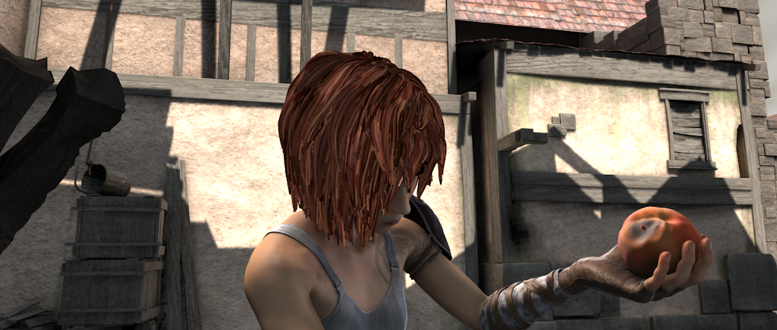
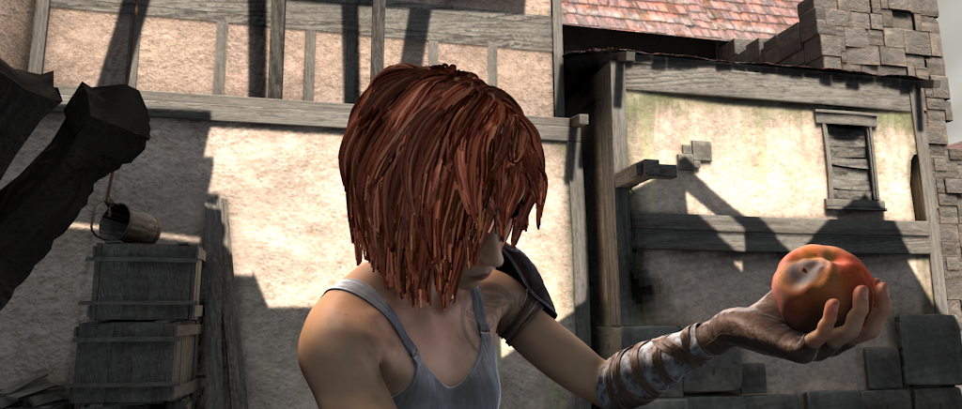
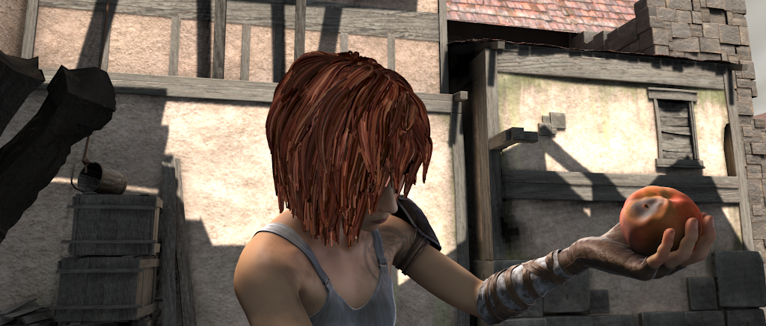
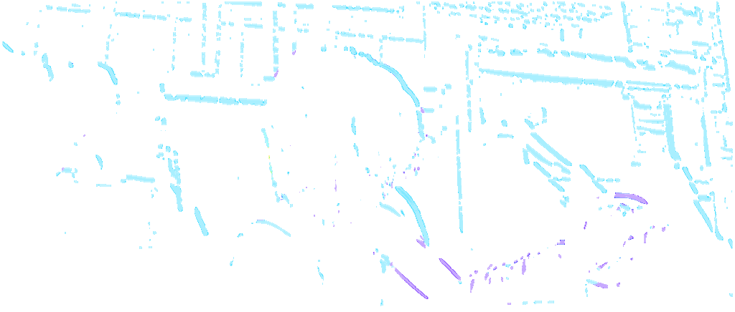
Inputs and Outputs
Input : 5 Consecutive Frame
1024 x 428 Pixel
Output : Optical flow Result
Motion of X and Y
FLO file
mp4 ->ppm -> kernel -> flo ->mp4

Slide 11
Optimization

Slide 12
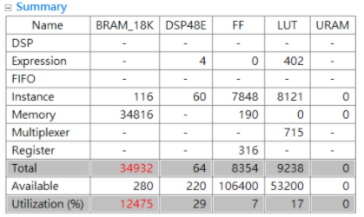
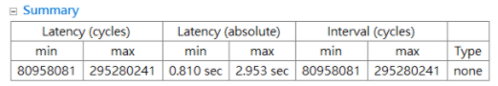
Analysis
Resource Utilization
Latency

Slide 13
Target
Memory customization
Memory bandwidth
Improve latency

Slide 14
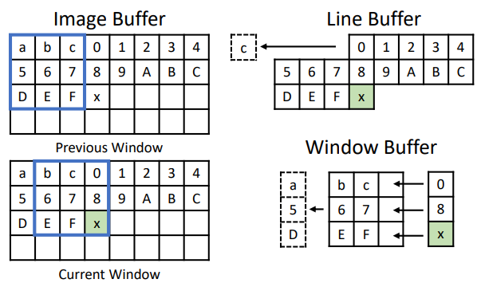
Image line buffer and window buffer
The kernels in optical flow have sliding window access patterns. As a result, line buffer and window buffer are introduced to exploit data reuse and reduce accesses to the next-level memory

Slide 15
Streaming dataflow optimization
After using line buffer and window buffer, the kernels in optical flow have perfectly balanced throughput, and access data in strict sequential order. As a result, execution of all stages can be perfectly overlapped to form a very deep image processing pipeline

Slide 16
Data packing
The hardware function kernel takes in five consecutive image frames. The corresponding pixels in the five frames are packed into a 64-bit integer for fast off-chip data transfer

Slide 17
Pragma
1. pragma HLS array_partition
2. pragma HLS pipeline
3. pragma HLS dependence
4. pragma HLS data_pack
5. pragma HLS dataflow
6. pragma HLS STREAM

Slide 18
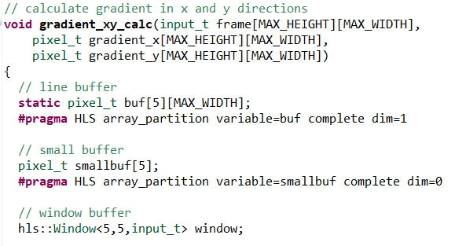
Array Partition
Line Buffer and Window Buffer
Array Partition
Multiple registers instead of one large memory
Improves the throughput

Slide 19
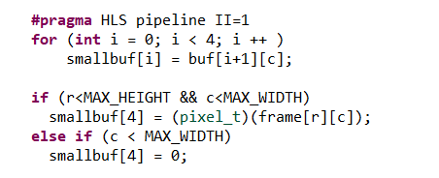
Pipeline
Read one pixel from input
Pipeline

Slide 20
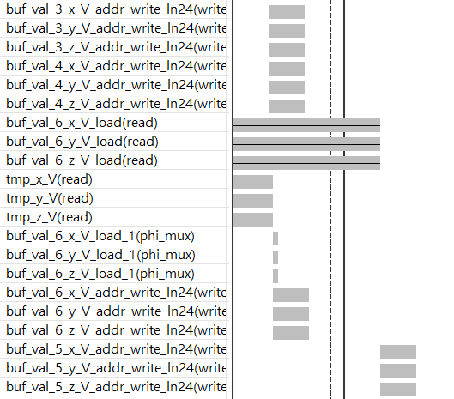
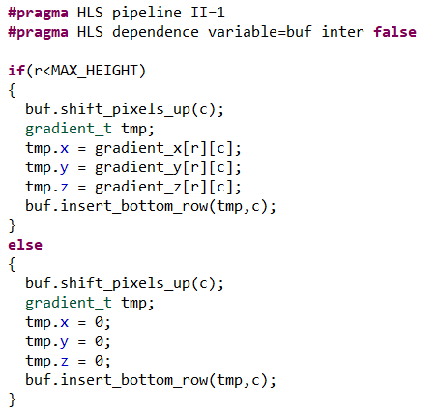
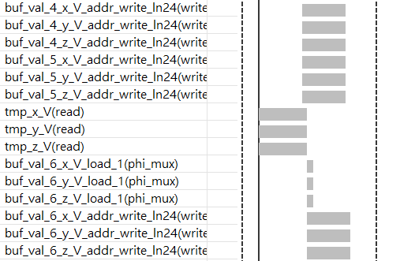
False Dependence

Slide 21
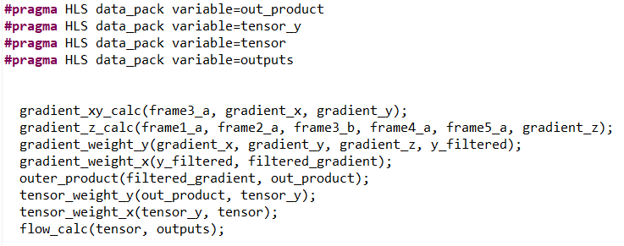
Data Pack

Slide 22
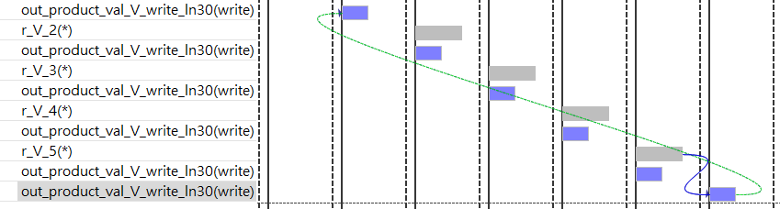
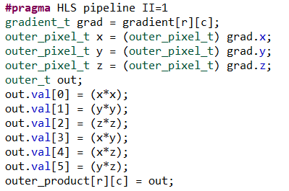
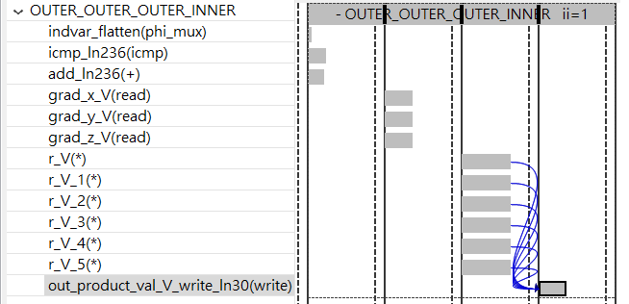
Pipeline II Violation

Slide 23
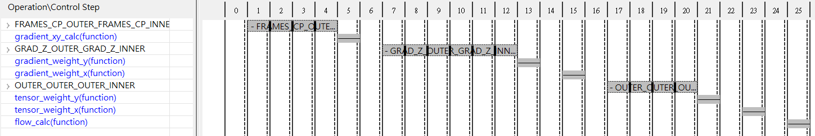
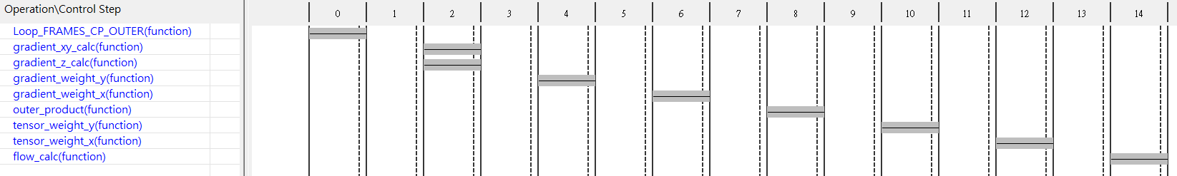
Dataflow

Slide 24
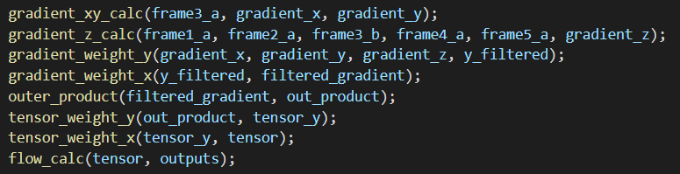
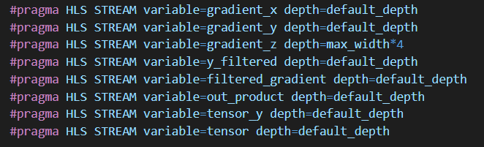
Stream
FIFO instead of RAM
more efficient communication

Slide 25
Timing & Resource Utilization

Slide 26
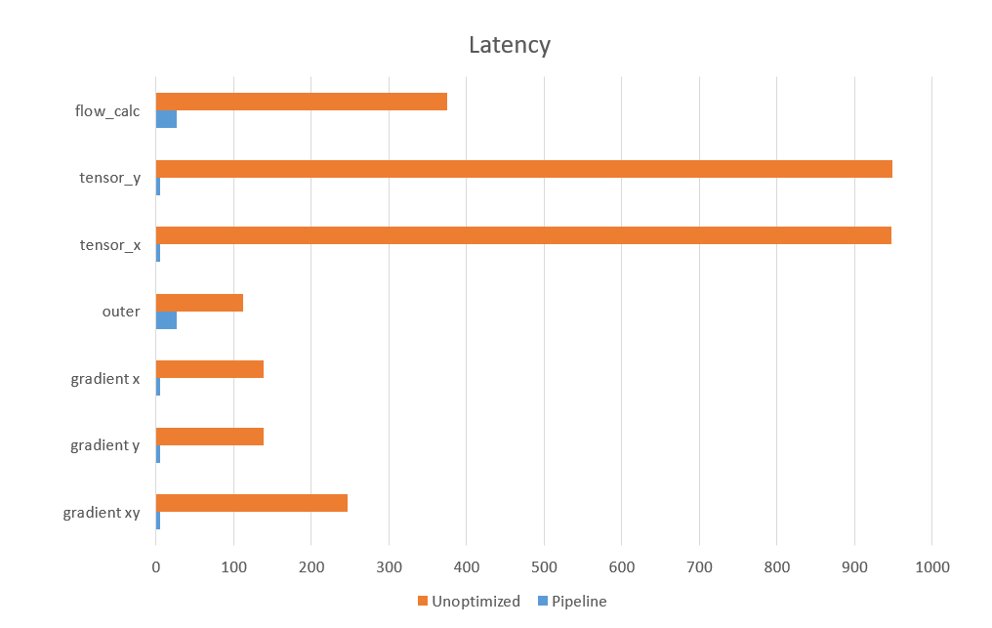
Pipelined Latency

Slide 27
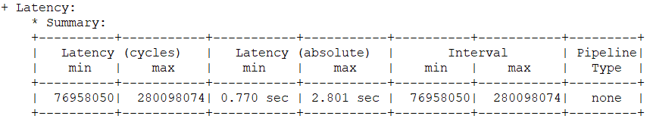
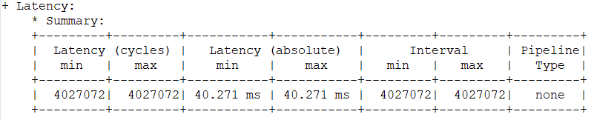
Pipeline Optimization

Slide 28
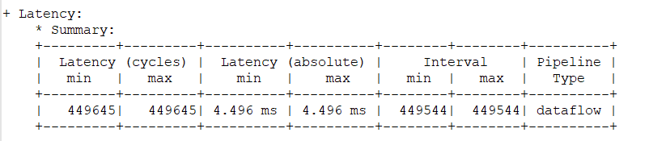
Dataflow Optimization

Slide 29
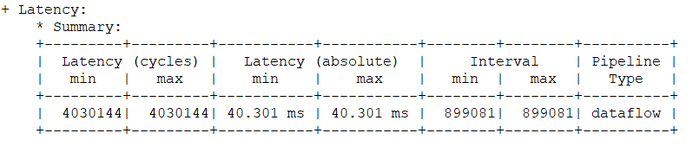
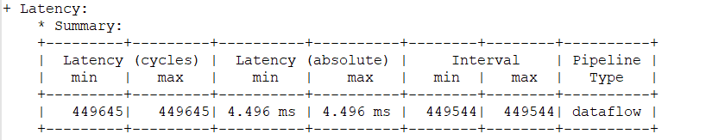
Stream Optimization

Slide 30
Timming
Pragma Type | Latency (Absolute Max) | Timming(100 MHz) | (200 MHz)
None | 1.169 (sec) | 8.690 ns
Pipeline | 40.271(ms) | 8.657 ns
w/o Stream | 35.806 (ms) | 8.510 ns
w/o Datapack | 26.851 (ms) | 8.657 ns
Optimization | 4.496 (ms) | 8.657 ns | 5.527

Slide 31
Compare
Utilization | Unoptimized | Optimization | Available
BRAM | 16770 | 135 | 280
DPS48E | 78 | 196 | 220
FF | 5388 | 33066 | 106400
LUT | 7376 | 26023 | 53200

Slide 32
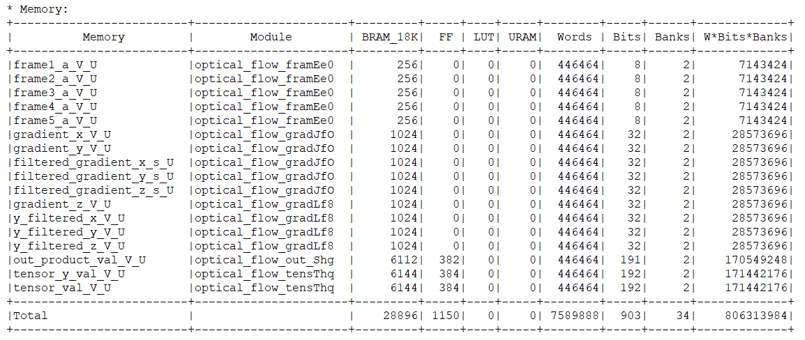
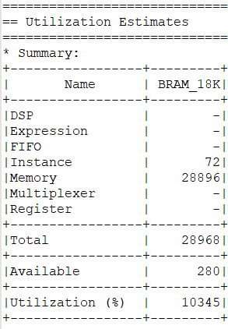
BRAM Utilization

Slide 33
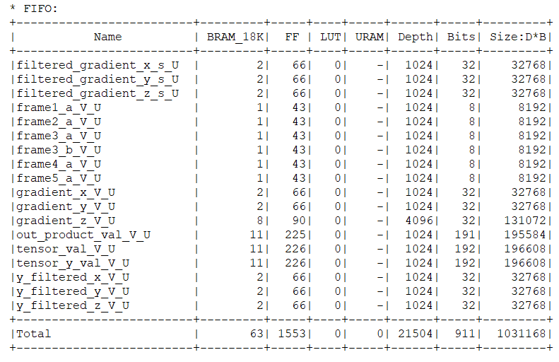
Stream FIFO

Slide 34
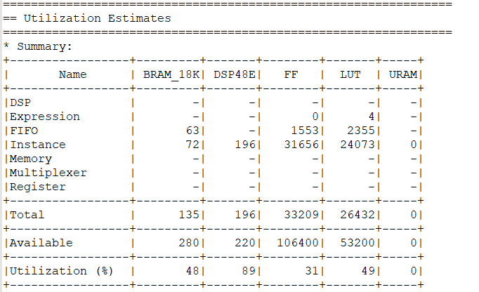
Stream FIFO

Slide 35
Resource
func/Utlis | BRAM | DSP48E | FF | LUT
gradient_xy | 8 | 8 | 835 | 1234
gradient_y | 42 | 42 | 2981 | 2200
gradient_x | 0 | 42 | 2203 | 1936
outer_product | 0 | 6 | 333 | 190
tensor_x | 0 | 36 | 1923 | 1748
tensor_y | 22 | 36 | 1960 | 1649
flow_calc | 0 | 24 | 21050 | 14358

Slide 36
Result

Slide 37


Slide 38
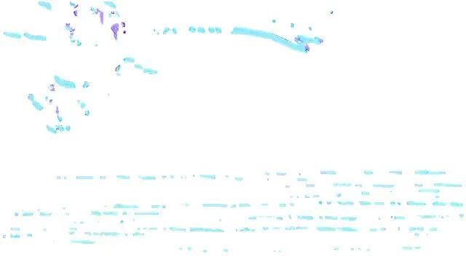
31.2 ms / frame
Blue : x direction
Purple : y direction

Slide 39
Reference
[1] Wiki - Lucas–Kanade method
[2] Rosetta: A Realistic High-Level Synthesis Benchmark Suite for Software Programmable FPGAs, 2018
[3] Optical Flow Estimation
[4] Introduction To Optical Flow

Slide 40
Github Link
https://github.com/yuweitt/Final-Project-Optical-Flow
Video
https://drive.google.com/drive/u/0/folders/1aZEH42efPpHFc-OHz4QsEv5FFpby9B18

